Slide 1
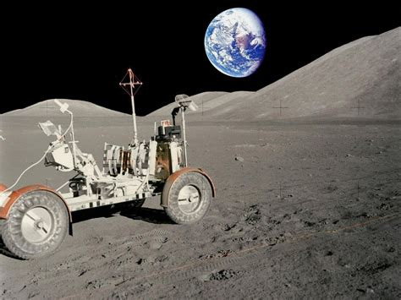
The Earth and Moon – Page 1
Hey, imagine the Earth is a basketball! If that's so, the moon would only be the size of a tennis ball! Now picture this, place the basketball on one end of a football field. Where do you think the tennis ball would be? Right next to it? No, it would actually be about 23.5 meters away, that's about a quarter of the football field! The Sun? It's as big as a seven-story building and it would be located 2.3 kilometers away if we keep up with our football field comparison. That's quite a walk, isn't it?
What object was the Earth compared to? ___________________________________________________________________
How big is the moon compare to the Earth in our example? ___________________________________________________________________
Where is the sun located in the football field example? ___________________________________________________________________
Ready for a fun journey? If we hopped in a car driving non-stop at 100km/h from Earth (the basketball), we'd reach the moon (the tennis ball) in about 6 months. That's quite a long trip, isn't it? But here's something even wilder! If we set off for the Sun (the seven-story building) at the same speed, it would take us a whopping 100 years! Imagine, if your great-great-grandparents had started the journey when they were your age, they still wouldn't have arrived! Space is vast, isn't it?
How long would it take to reach the moon if we drove non-stop at 100km/h from Earth? ___________________________________________________________________
How long would it take to reach the Sun at the same speed? ___________________________________________________________________
What comparison is used for Earth in this paragraph? ___________________________________________________________________

Slide 2
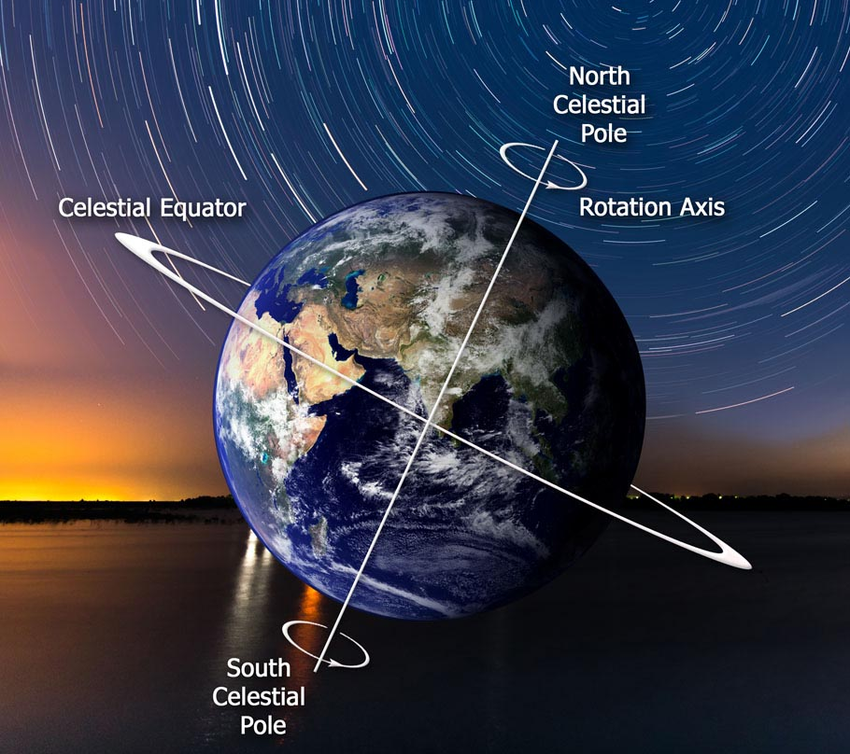
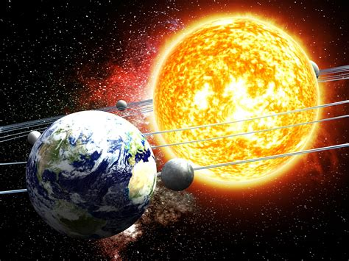
The Earth and Moon – Page 2
Let's spin this into space now! The Earth rotates on its own axis and takes about 24 hours to do so. That's what gives us day and night! The moon spins too, but it takes about 27 days for one rotation. This is why we see different shapes of the moon throughout the month. The Sun also spins, but because it's so huge, it takes about 25 days for the sunspots near its equator to make one complete spin!
How long does it take for the Earth to rotate on its own axis? __________________________________________________________________
How long does it take for the moon to rotate once? __________________________________________________________________
Why do we see different shapes of the moon throughout the month? __________________________________________________________________
Now, picture a game of tug-of-war! The Earth and the moon pull on each other, and it's gravity making that happen. This pull is what makes our ocean tides rise and fall! Even though the Sun is 400 times further from us than the moon, its pull is super strong and influences our tides too. But don't worry, because the moon is closer, it has a stronger influence on our tides than the Sun. Isn't it amazing how these space bodies play a big tug-of-war game?
What makes the Earth and the moon pull on each other? __________________________________________________________________
What is the result of this tug-of-war on Earth? __________________________________________________________________
Who has the stronger influence on Earth’s tides – the sun or the moon? __________________________________________________________________

